Slide 1
Movie World System
Oskars Arajs
Balkis Ibrahim
Taha Mohamed Alzein
Fadi Atia Dasus
Muhammad Nadeem
Supervised by
Christian Flinker Sandbeck
Ole Ilsgaard Hougaard

Slide 2
Introduction
What is the project?

Slide 3
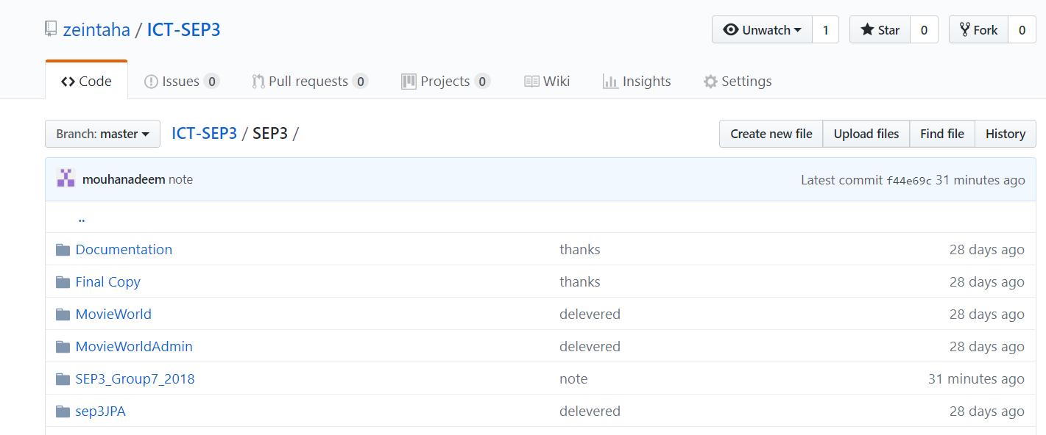
Github Version Control

Slide 4
scrum
Product owner: All team members
Scrum master: Taha Alzien
Development team: Taha, Balkis, Fadi, Oskars and Nadeem

Slide 5
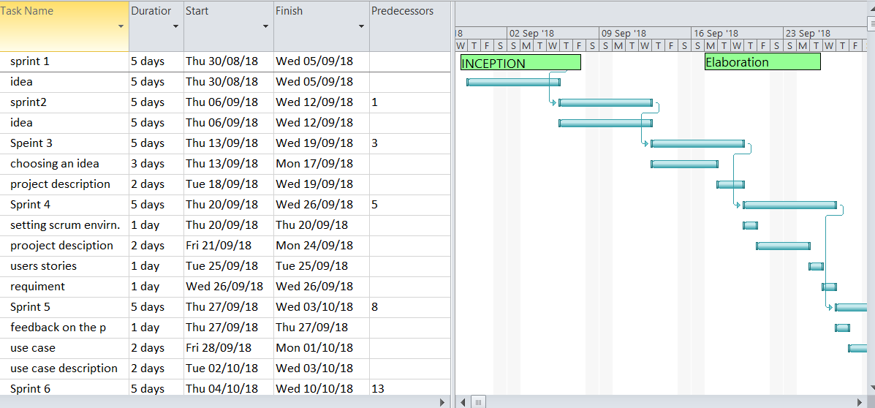
Sprint backlog backlog

Slide 6
Burndown chart

Slide 7
Sprint review

Slide 8
User Stories
1. As an Admin I want to be able to add the movie to the system so that the Customer can see it.
2. As an Admin I want to be able to remove a movie from the system so that I can delete a movie.
3. As a Guest, I want to be able to select a movie so that I can see the movie details.
4. As a Guest, I want to be able to book a ticket for a certain movie, so that I can reserve a place for that movie.
5. As a Customer, I want to be able to stream the movie, so that I can watch the movie at home.
6. As a Guest, I want to be able to pay using an electronic payment method for my reservation or subscription so that I can have these services.
7. As an Admin I want to be able to read messages so that I can get Guest input.
8. As a Guest, I want to be able to send a message, so that the Admin can read it.

Slide 9
Functional Requirement
1. The system must allow the Admin to be able to add a movie.
2. The system must allow the Admin to be able to remove a movie.
3. The system must allow the Guest to be able to see a list of movies.
4. The system must allow the Guest to be able to get movie information.
5. The system must allow the Guest to be able to book a cinema ticket for the selected movie.
6. The system must allow the Guest to be able to purchase a subscription electronically for streaming.
7. The system must allow the Customer to be able to get a ticket through his email.
8. The system must allow the Customer to be able to stream a movie.
9. The system must allow the Admin to read messages coming from Guests.
10. The system must allow the Guest to send messages to the Admin.

Slide 10
Non-Functional Requirements
1. The system must be implemented as a heterogeneous system (Server in Java, Client in .NET).
2. The system must be 3-tier architecture.
3. The system must use web services
4. The system must use a protocol for Sockets
5. The system must include GUI for two clients (Customer and Admin)

Slide 11
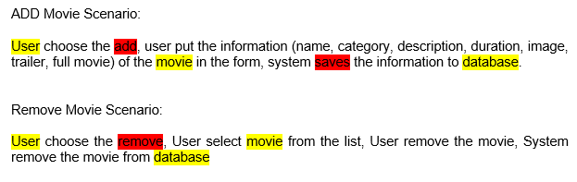
Scenarios

Slide 12
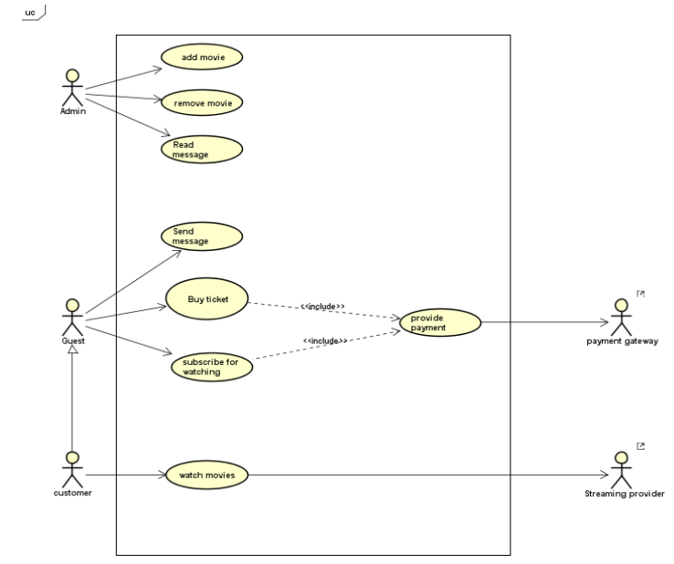
Use Case Diagram

Slide 13
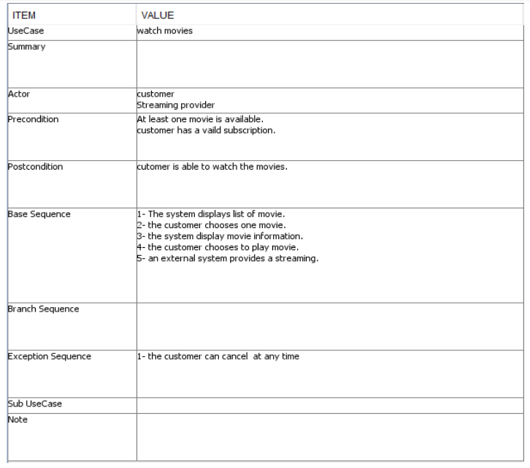
Use Case Description

Slide 14
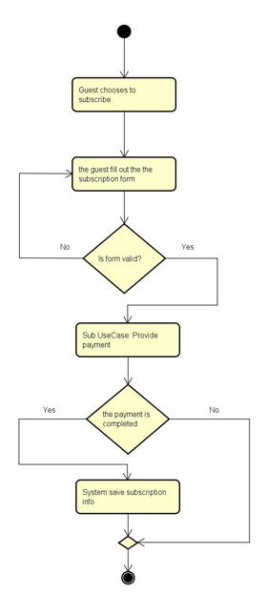
Activity diagram

Slide 15
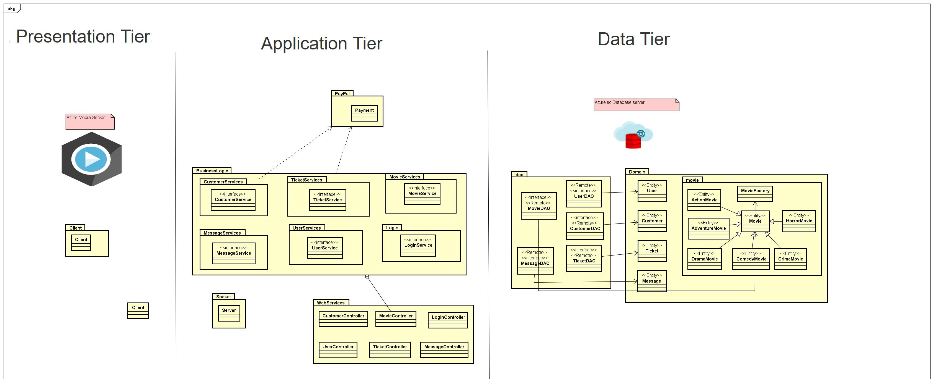
Conseptual Diagram

Slide 16
Database

Slide 17

Security

Slide 18
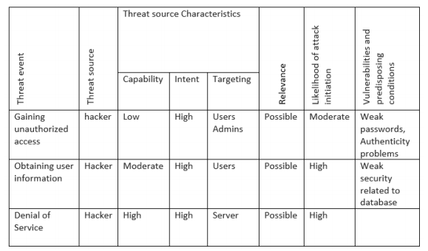
Risk assessment model

Slide 19
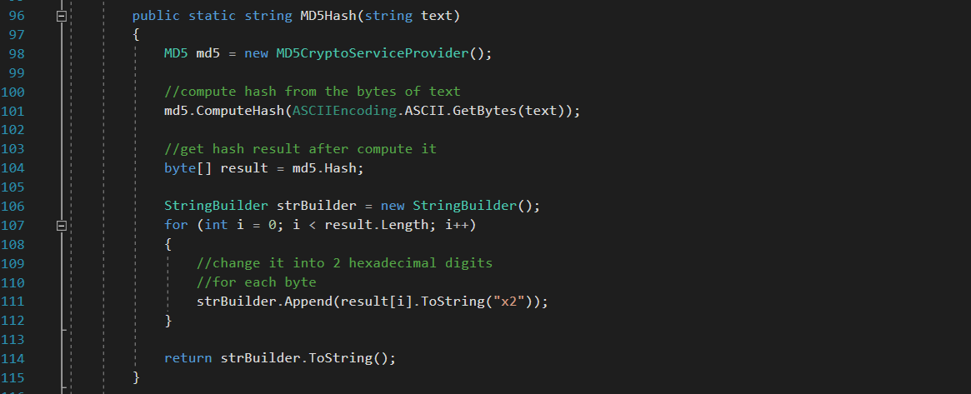
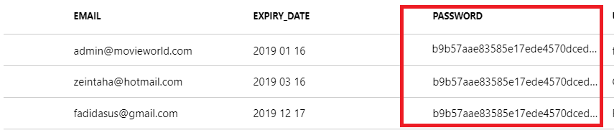
MD5 hash function
Password protection

Slide 20
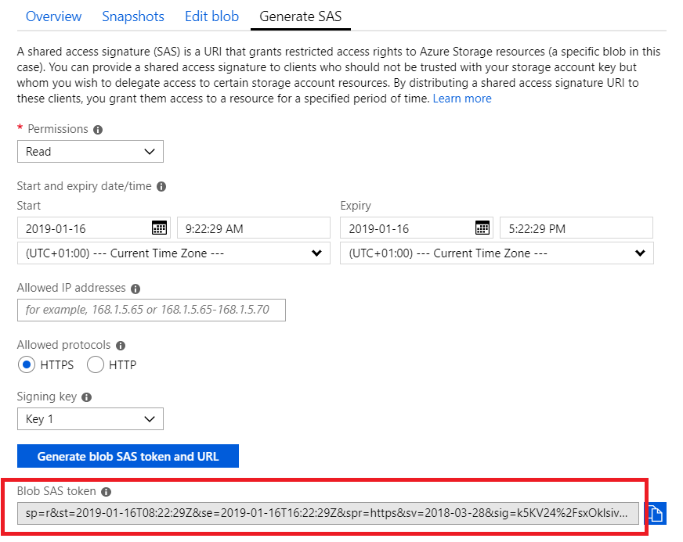

Slide 21
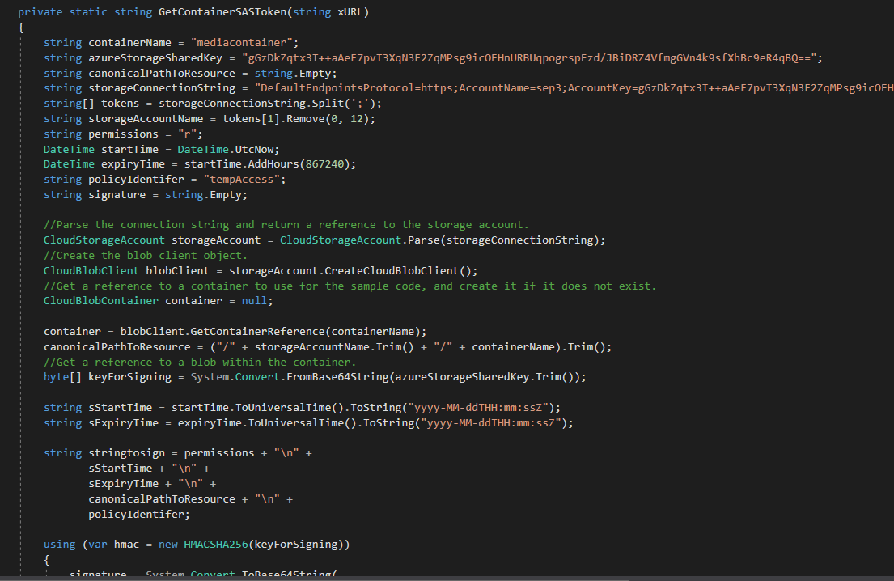

Slide 22
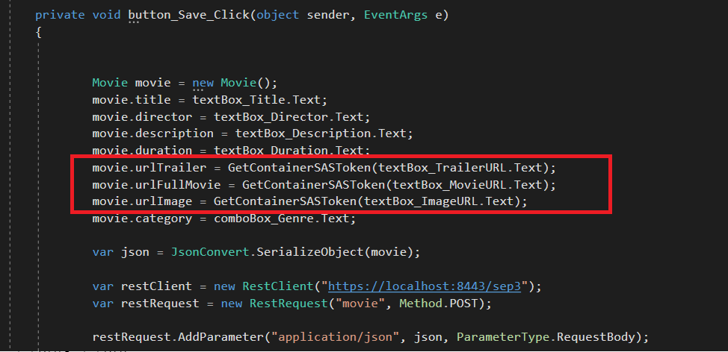

Slide 23
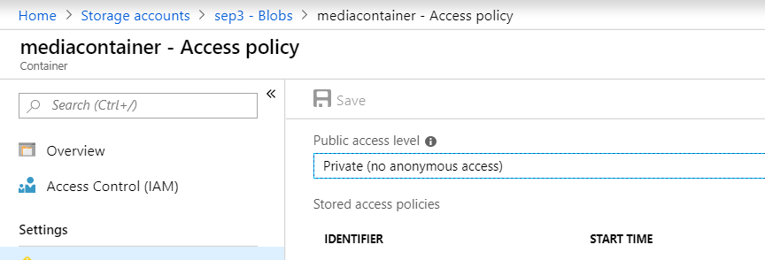

Slide 24
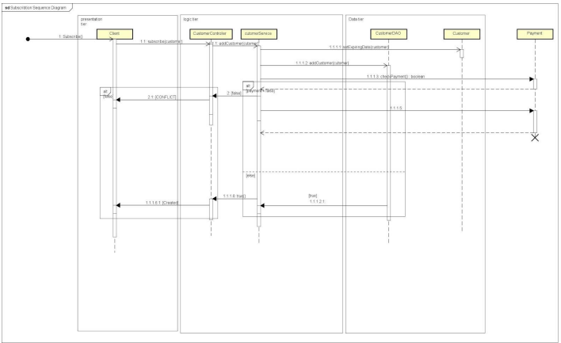
Sequence Diagram
Notes:
This sequence diagram illustrates the function of adding a customer to the database. Starting from client side where customer clicked the button of (Subscribe), the action will be taken to the server, where the business logic will be applied. The first step in streaming a movie is subscribing to the service. When the subscribe button has been clicked, addCustomer method will be invoked from customerController, where the business logic will be executed. So the first method in the chain will be setExpireDate(), in order to set an end subscription date. Then the system will check the payment status and If there is a customer with the same username in the database. Depending on the result of the previous conditions. If payment is approved and there is no customer with the same username in the database, the system will create a new customer, and a created status will be returned to the client. Otherwise, a conflict will occur.

Slide 25
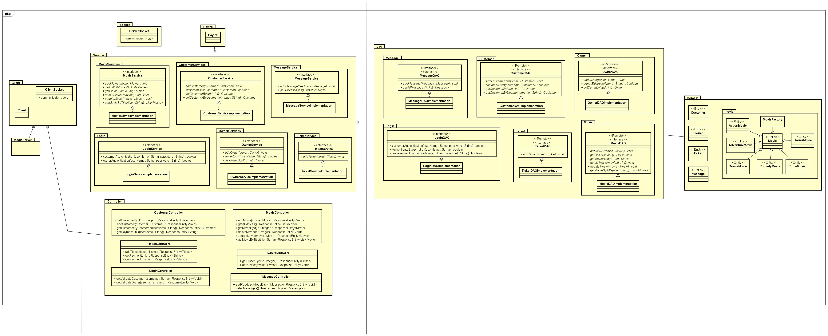
Class Diagram

Slide 26
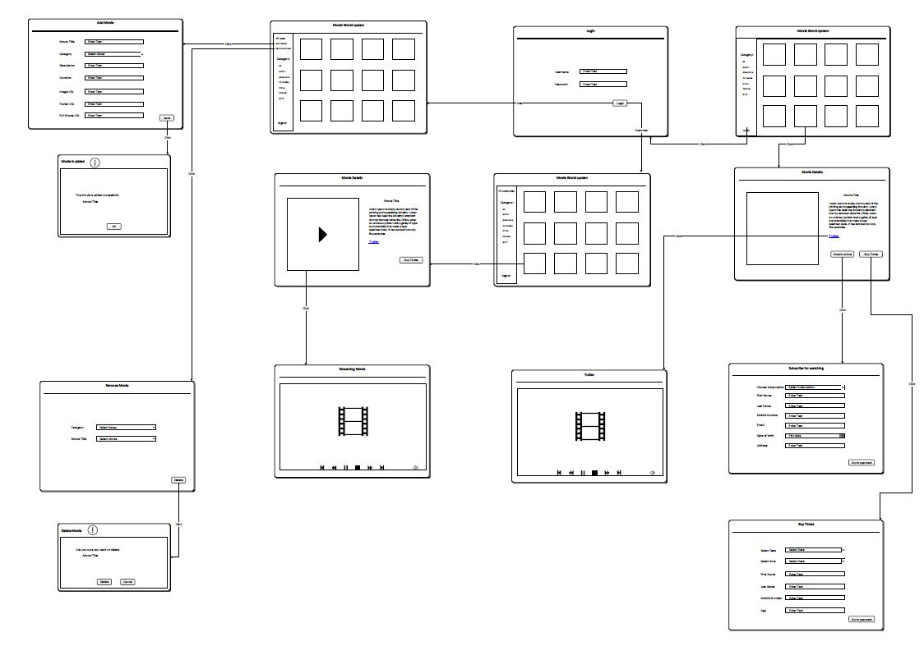
Wireframe

Slide 27
Graphical User Interface for Guest

Slide 28
Graphical User Interface for Guest

Slide 29
Graphical User Interface for Customer

Slide 30
Graphical User Interface for Admin

Slide 31
Socket

Slide 32
Testing

Slide 33
Conclusion and Future Work

